Slide 1

Design and Simulation of a 4-Bit Universal Shift Register Using Logic Gates
A Complete Structural Gate-Level Implementation and Verification Framework in Logisim

Slide 2

Project Objectives & Technical Scope
Core Project Goals
• Design an fully functional 4-bit Universal Shift Register (USR).
• Avoid high-level pre-built macro components inside Logisim.
• Implement core operations natively utilizing discrete logic gate structures.
• Verify operations dynamically via structural simulation test benches.
Design & Tool Constraints
• Simulation Environment: Logisim / Logisim-Evolution layout engine.
• Control Structures: Custom built using basic AND, OR, and NOT configurations.
• Storage Elements: Exactly four Edge-Triggered D-Flip Flops (D-FF).
• Global Synchronicity: Single synchronized global clock and Master Reset distribution.

Slide 3
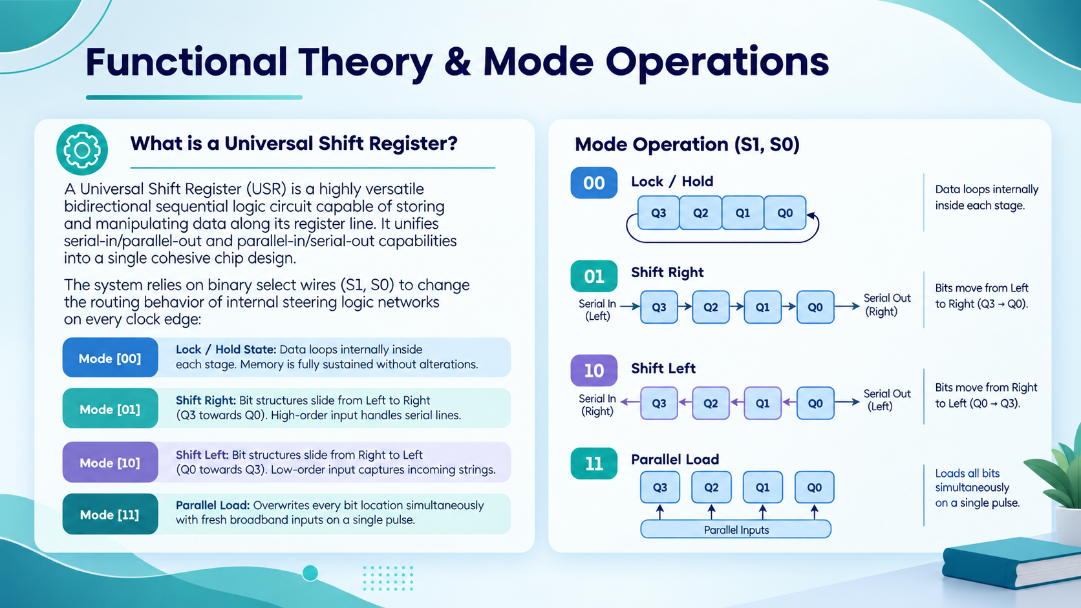
Functional Theory & Mode Operations
What is a Universal Shift Register?
A Universal Shift Register (USR) is a highly versatile bidirectional sequential logic circuit capable of storing and manipulating data along its register line. It unifies serial-in/parallel-out and parallel-in/serial-out capabilities into a single cohesive chip design.
The system relies on binary select wires (S1, S0) to change the routing behavior of internal steering logic networks on every clock edge:
➔ Mode [00] - Lock / Hold State: Data loops internally inside each stage. Memory is fully sustained without alterations.
➔ Mode [01] - Shift Right: Bit structures slide from Left to Right (Q3 towards Q0). High-order input handles serial lines.
➔ Mode [10] - Shift Left: Bit structures slide from Right to Left (Q0 towards Q3). Low-order input captures incoming strings.
➔ Mode [11] - Parallel Load: Overwrites every bit location simultaneously with fresh broadband inputs on a single pulse.

Slide 4
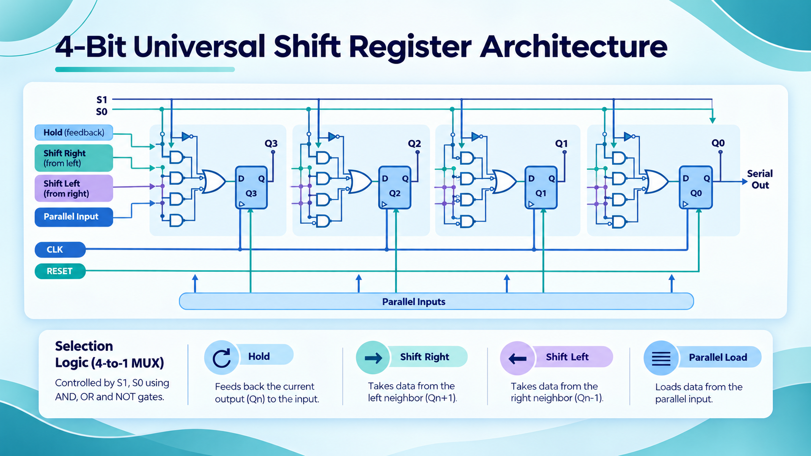
System Truth Table & Routing Rules
S1 (Select 1) | S0 (Select 0) | Operation Mode | Data Steering Logic Path
0 | 0 | Hold / No Change | Qn ➔ Dn (Output tracks back to own input)
0 | 1 | Shift Right | Qn+1 ➔ Dn (Serial input right hooks into Stage 3)
1 | 0 | Shift Left | Qn-1 ➔ Dn (Serial input left hooks into Stage 0)
1 | 1 | Parallel Load | In ➔ Dn (All external lines load simultaneously)

Slide 5
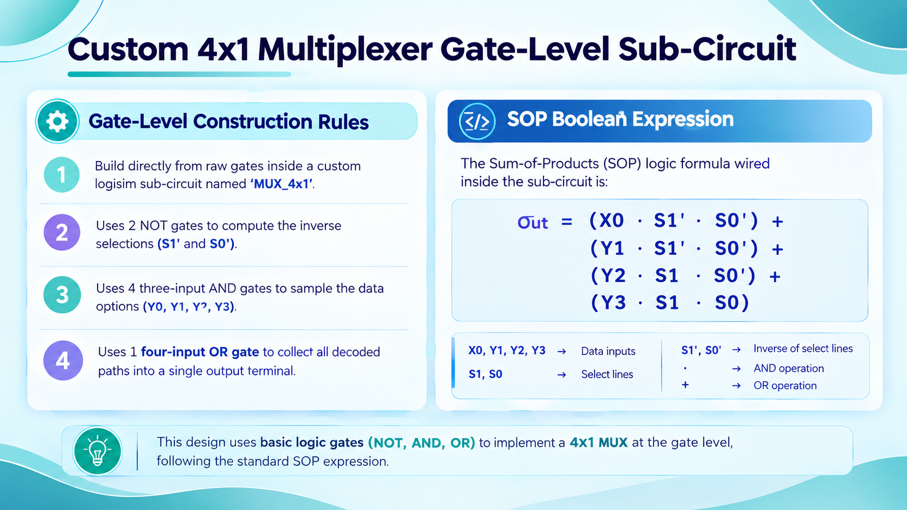
Custom 4x1 Multiplexer Gate-Level Sub-Circuit
Gate-Level Construction Rules
• Built strictly from raw gates inside a custom Logisim sub-circuit named 'MUX_4x1'.
• Uses 2 NOT Gates to compute the inverse selections (S1' and S0').
• Uses 4 Three-Input AND Gates to sample the data options (Y0, Y1, Y2, Y3).
• Uses 1 Four-Input OR Gate to collect all decoded paths into a single output terminal.
SOP Boolean Expression
The Sum-of-Products (SOP) logic formula wired inside the sub-circuit is:
Out = (Y0 · S1' · S0') +
(Y1 · S1' · S0) +
(Y2 · S1 · S0') +
(Y3 · S1 · S0)

Slide 6
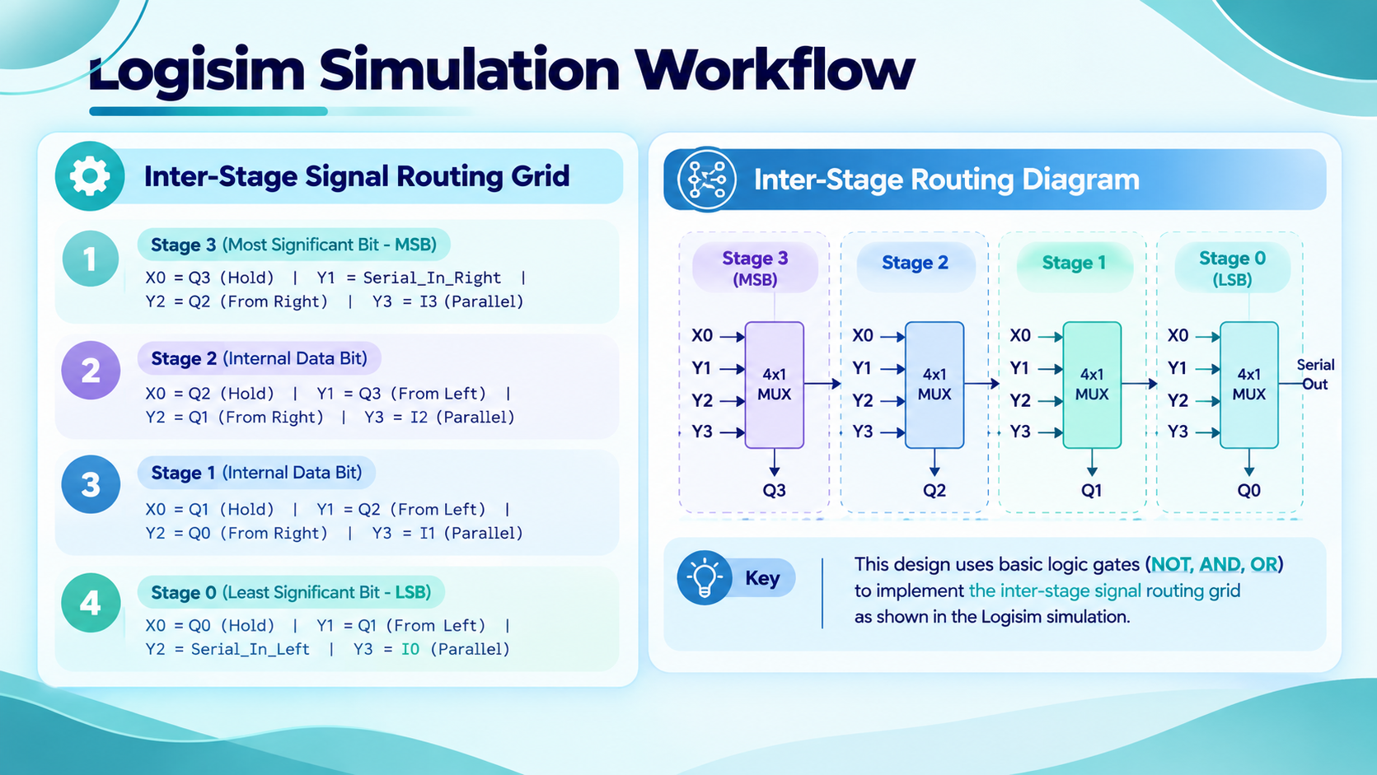
Logisim Simulation Workflow
Inter-Stage Signal Routing Grid
Stage 3 (Most Significant Bit - MSB):
Y0 = Q3 (Hold) | Y1 = Serial_In_Right | Y2 = Q2 (From Right) | Y3 = I3 (Parallel)
Stage 2 (Internal Data Bit):
Y0 = Q2 (Hold) | Y1 = Q3 (From Left) | Y2 = Q1 (From Right) | Y3 = I2 (Parallel)
Stage 1 (Internal Data Bit):
Y0 = Q1 (Hold) | Y1 = Q2 (From Left) | Y2 = Q0 (From Right) | Y3 = I1 (Parallel)
Stage 0 (Least Significant Bit - LSB):
Y0 = Q0 (Hold) | Y1 = Q1 (From Left) | Y2 = Serial_In_Left | Y3 = I0 (Parallel)

Slide 7
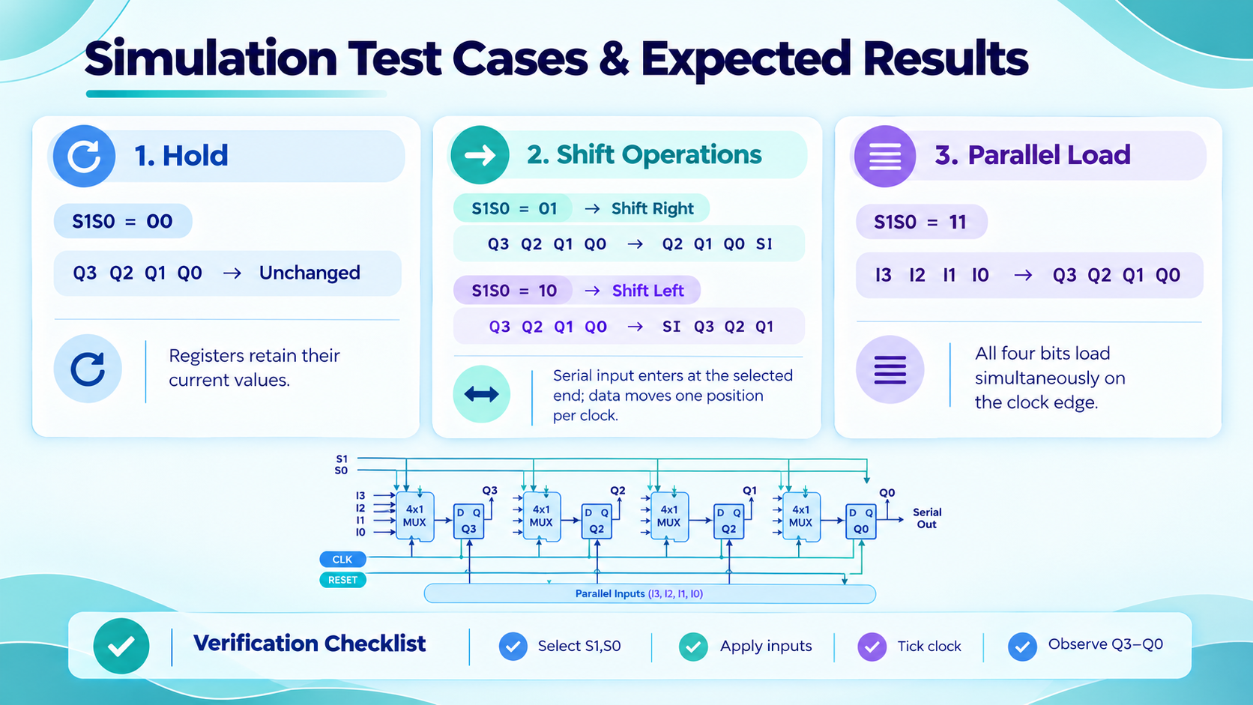
Logisim Tool Setup & Step-by-Step Simulation
1. Main Circuit Assembler
Instantiate 4 instances of your custom MUX sub-circuit alongside 4 standard D-Flip Flops from Logisim's 'Memory' library tree. Wire the MUX outputs directly to the D-inputs.
2. Control Routing
Tie the Clock inputs of all 4 flip-flops together to a single global Clock item. Join the select wires S1 and S0 of all four MUX blocks together using a unified 2-bit Input Switch element.
3. Interactive Execution
Use Logisim's 'Poke Tool' (Hand Icon) to dynamically alter the values of input pins. Step the system using Ctrl+T (Simulate ➔ Tick Half Cycle) to force register evaluations.

Slide 8
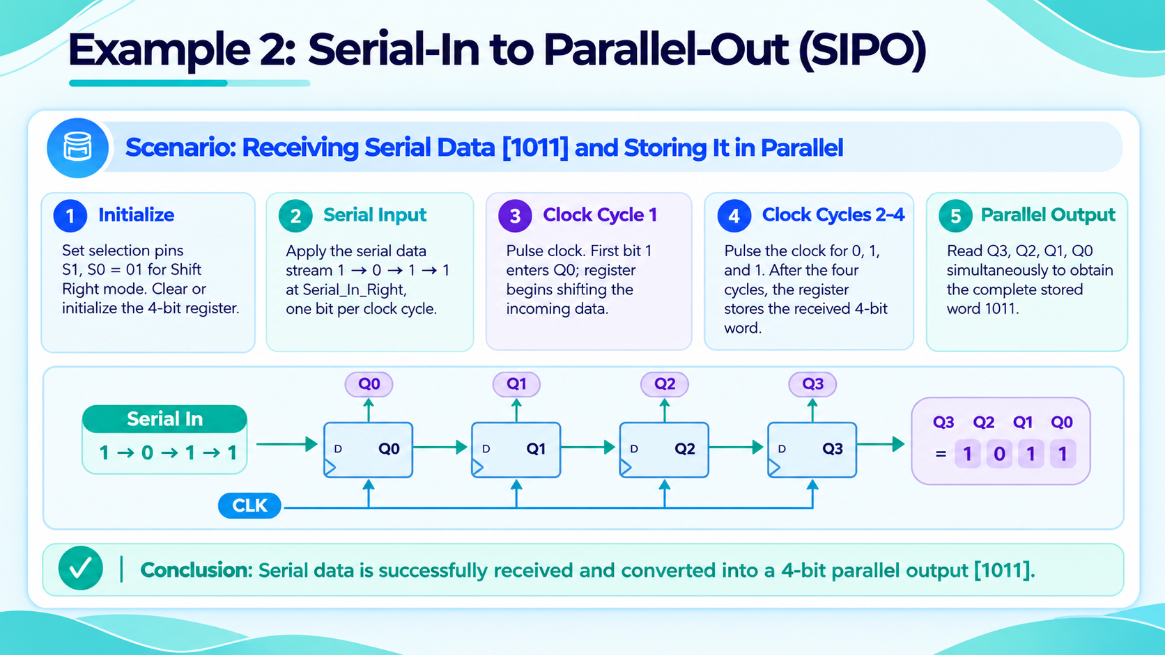
Example 1: Parallel-In to Serial-Out (PISO)
Scenario: Loading Binary Data [1011] and Streaming Out Serially
Step 1 (Parallel Load): Set Selection pins S1, S0 = 11. Hook up external values I3=1, I2=0, I1=1, I0=1. Cycle the clock line once. The system memory immediately registers Q3, Q2, Q1, Q0 = 1011.
Step 2 (Initialize Streaming): Toggle Select switches S1, S0 to 01 (Shift Right Mode). Tie the Serial_In_Right line to a constant logic '0'. The LSB output node (Q0) is our serial streaming out tap point.
Step 3 (Clock Cycle 1): Pulse clock. Value shifts right. Q3 becomes 0. Main registers change to 0101. Q0 pin yields '1'.
Step 4 (Clock Cycle 2): Pulse clock. Value shifts right. Q2 becomes 0. Main registers change to 0010. Q0 pin yields '1'.
Step 5 (Clock Cycle 3): Pulse clock. Value shifts right. Q1 becomes 0. Main registers change to 0001. Q0 pin yields '0'.
Conclusion: The 4-bit block has been successfully converted into a sequential single-wire stream [1, 1, 0, 1] over time.

Slide 9
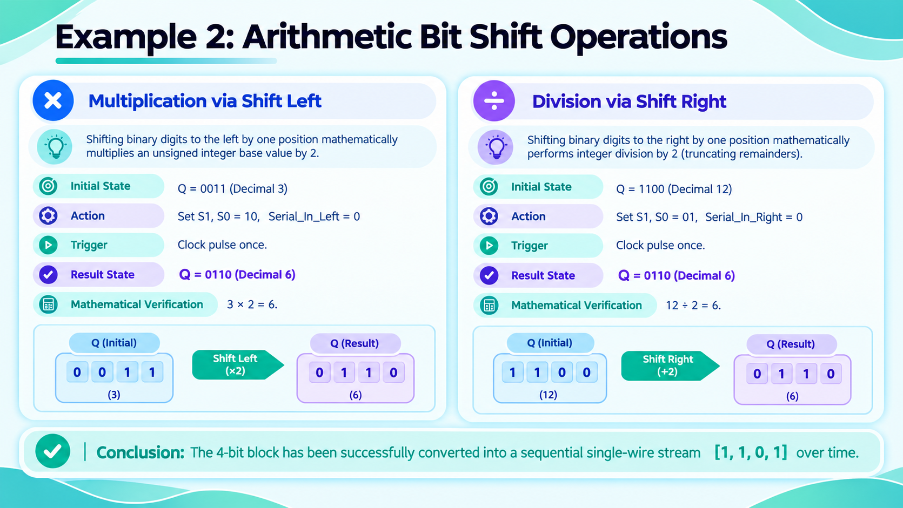
Example 2: Arithmetic Bit Shift Operations
Multiplication via Shift Left
Shifting binary digits to the left by one position mathematically multiplies an unsigned integer base value by 2.
➔ Initial State: Q = 0011 (Decimal 3)
➔ Action: Set S1, S0 = 10, Serial_In_Left = 0
➔ Trigger Clock pulse once.
➔ Result State: Q = 0110 (Decimal 6)
➔ Mathematical Verification: 3 × 2 = 6.
Division via Shift Right
Shifting binary digits to the right by one position mathematically performs integer division by 2 (truncating remainders).
➔ Initial State: Q = 1100 (Decimal 12)
➔ Action: Set S1, S0 = 01, Serial_In_Right = 0
➔ Trigger Clock pulse once.
➔ Result State: Q = 0110 (Decimal 6)
➔ Mathematical Verification: 12 ÷ 2 = 6.

Slide 10
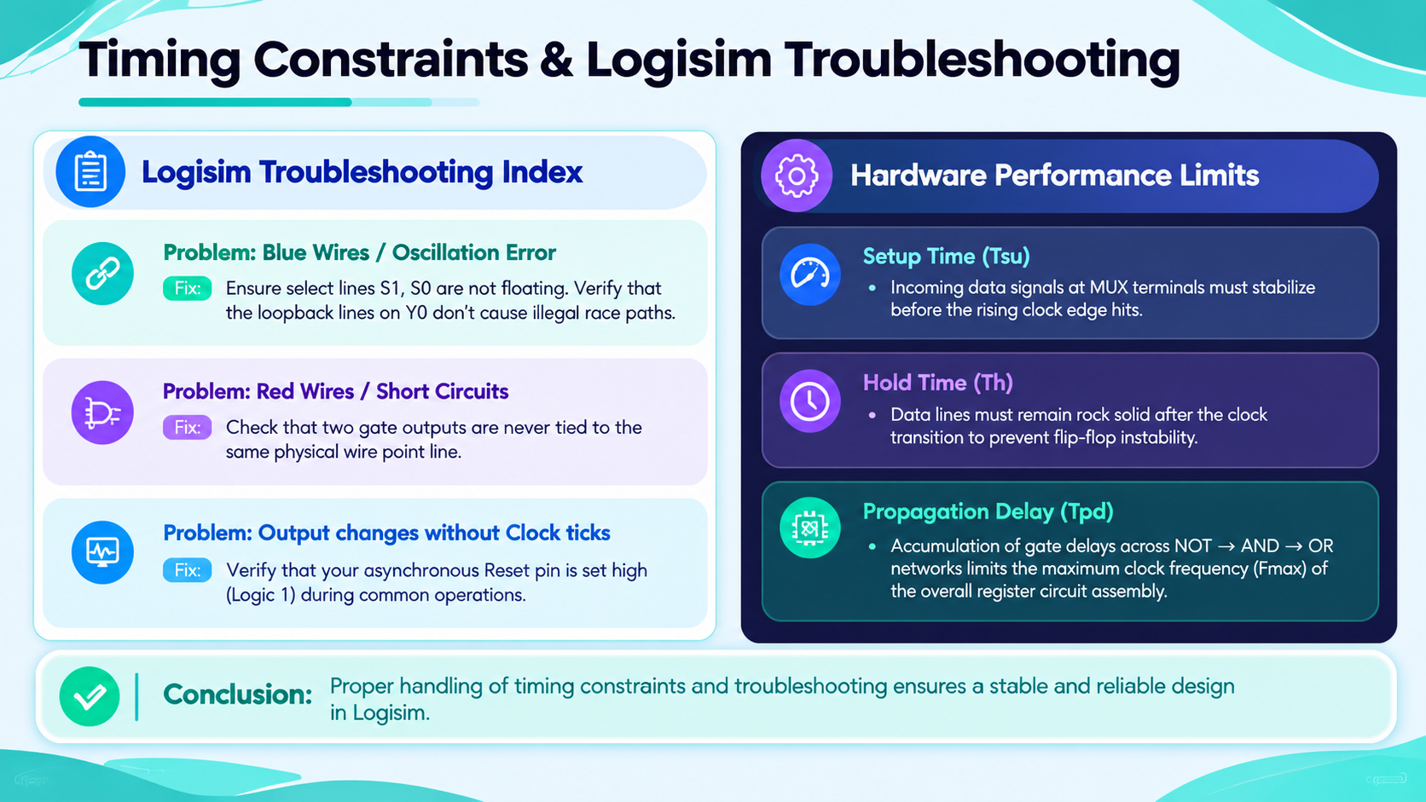
Timing Constraints & Logisim Troubleshooting
Logisim Troubleshooting Index
Problem: Blue Wires / Oscillation Error
Fix: Ensure select lines S1, S0 are not floating. Verify that the loopback lines on Y0 don't cause illegal race paths.
Problem: Red Wires / Short Circuits
Fix: Check that two gate outputs are never tied to the same physical wire point line.
Problem: Output changes without Clock ticks
Fix: Verify that your asynchronous Reset pin is set high (Logic 1) during common operations.
Hardware Performance Limits
• Setup Time (Tsu): Incoming data signals at MUX terminals must stabilize before the rising clock edge hits.
• Hold Time (Th): Data lines must remain rock solid after the clock transition to prevent flip-flop instability.
• Propagation Delay (Tpd): Accumulation of gate delays across NOT ➔ AND ➔ OR networks limits the maximum clock frequency (Fmax) of the overall register circuit assembly.

Slide 11


